Slide 1

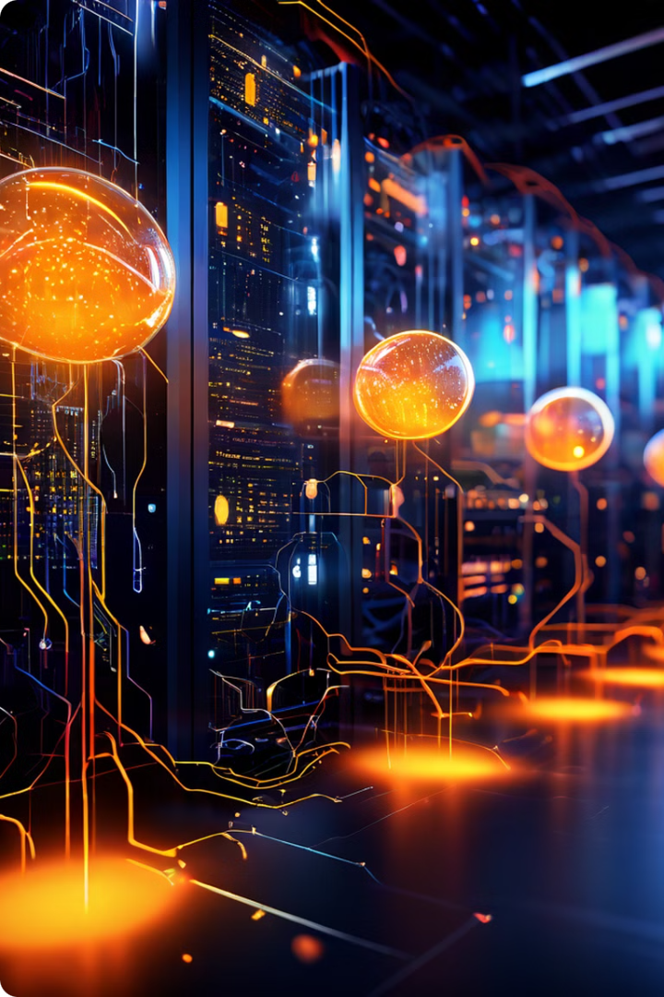
AI and Microservices: A Modern Approach
Microservices are small, independent units of software designed to perform specific tasks within a larger system. AI-based microservices utilize AI techniques to improve efficiency and performance, offering advanced features and capabilities.

Slide 2
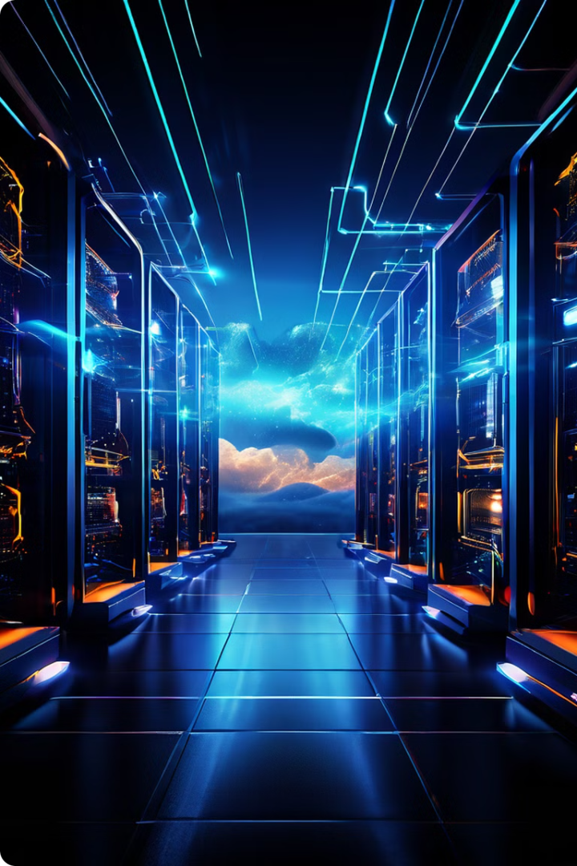
Understanding Cloud-Native Computing
Cloud-native computing leverages cloud technologies for software development and deployment. It utilizes microservices, containers, and serverless computing for agility and scalability. This approach enables rapid innovation and efficient resource utilization.
Cloud
Edge
Centralized infrastructure with shared resources. Suitable for large-scale data processing and model training.
Distributed computing at the edge of the network. Ideal for real-time applications and low-latency requirements.

Slide 3
AI in the Cloud vs. at the Edge
Cloud computing provides centralized resources for AI, enabling large-scale training and model deployment. Edge computing utilizes local devices for processing, offering low latency and enhanced privacy. Both approaches offer unique benefits for different AI applications.
Cloud
Edge
Hybrid
Suitable for tasks like large-scale data processing, model training, and centralized data storage.
Ideal for applications requiring real-time responses, low latency, privacy-sensitive data processing, and offline functionality.
Combines the strengths of cloud and edge for optimal performance and efficiency. This involves offloading computationally intensive tasks to the cloud while handling real-time interactions at the edge.

Slide 4

Serverless OpenAI API vs. Cloud-Hosted Open Source LLMs
Serverless OpenAI API offers a convenient and scalable solution for accessing and utilizing powerful LLMs. Cloud-hosted Open Source LLMs provide flexibility and control over model customization and deployment.
1
Serverless OpenAI API
2
Cloud-Hosted Open Source LLMs
Pre-trained models, simple integration, and scalability.
Customization, cost-efficiency, and greater control over model deployment.

Slide 5
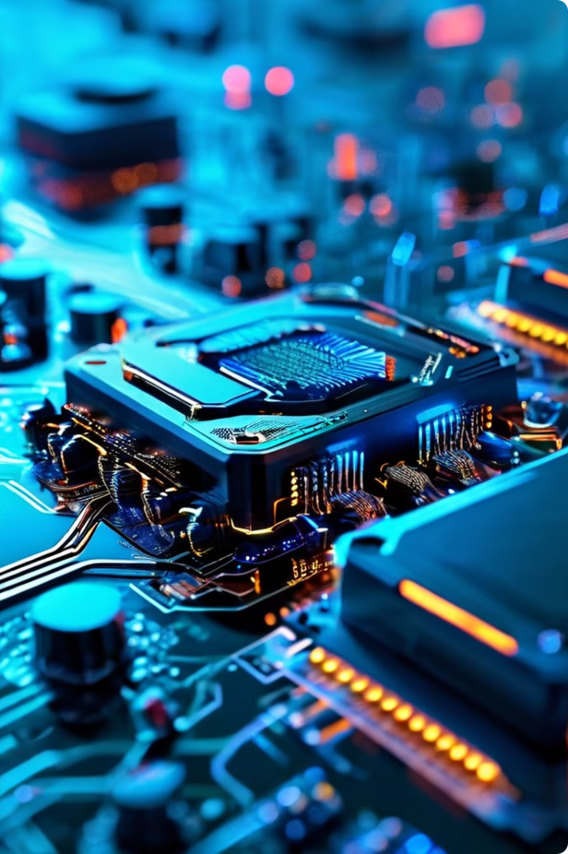



Nvidia NIM and Kubernetes-Powered Cloud Services
Nvidia NIM is a framework designed for AI model development and deployment within Kubernetes. It simplifies the process of creating and managing AI applications within a cloud environment. Kubernetes offers a platform for orchestrating and managing containers, enabling efficient resource utilization and scalability.
Basic Infrastructure
Underlying hardware and network infrastructure.
Kubernetes
Container orchestration platform for managing containers.
Cloud Services
Platform-as-a-Service (PaaS) and Software-as-a-Service (SaaS) offerings.

Slide 6

Exploring AI Stacks: A Journey into the Future of Intelligence
AI is revolutionizing the world, and understanding AI stacks is crucial for harnessing this power. This presentation will delve into various AI stack approaches, highlighting their strengths, limitations, and potential use cases.

Slide 7

Local AI Microservices Development Stack
Microservices Architecture
Deployment & Orchestration
Break down complex AI models into smaller, independent services, enabling modularity, scalability, and faster development.
Deploy and manage microservices in a local environment, facilitating seamless integration and streamlined operation of the AI system.
1
2
3
Local Development Environment
Develop and test AI models locally, providing direct control and faster iteration cycles for rapid prototyping and experimentation.

Slide 8
Serverless with OpenAI APIs
OpenAI APIs
Serverless Platform
Reduced Infrastructure Management
Leverage pre-trained models like GPT-3 and DALL-E 2 for natural language processing, text generation, and image creation.
Utilize serverless platforms like AWS Lambda or Google Cloud Functions to automatically scale resources based on demand.
Focus on developing AI applications and leave server management to the platform, simplifying development and lowering operational overhead.

Slide 9

Custom AI Stack with PyTorch, Llama, and Kubernetes
PyTorch
Llama
A powerful deep learning framework for building custom models, providing flexibility and control over model architecture and training processes.
A large language model known for its efficiency and performance, offering advanced capabilities for text generation, translation, and more.
Kubernetes
An open-source container orchestration platform that automates deployment, scaling, and management of AI workloads across multiple servers.

Slide 10
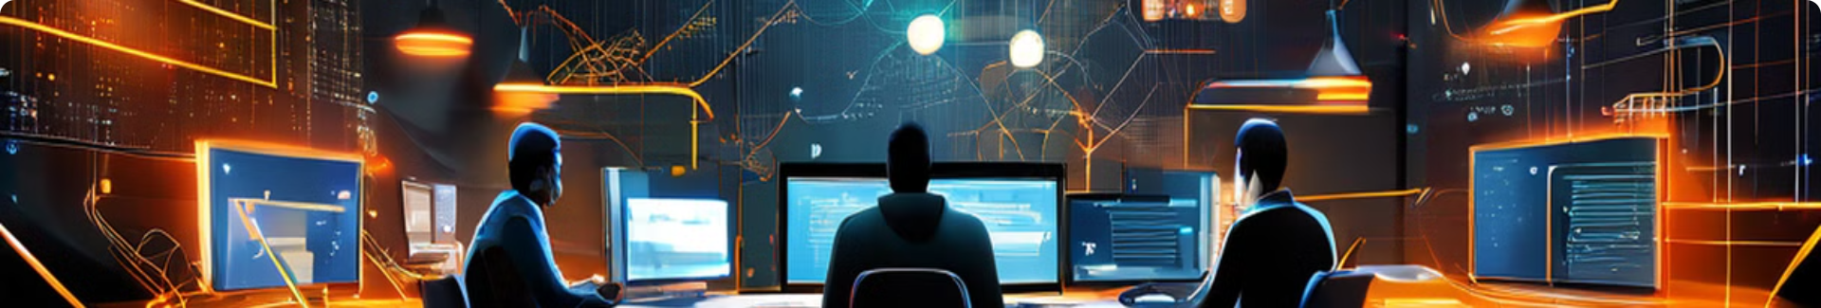



The Rise of Agentic AI: A New Era of Intelligent Collaboration
Autonomous Agents
Human-AI Partnerships
Augmented Intelligence
AI agents capable of independent action and decision-making, learning and adapting to changing environments and collaborating with humans.
AI agents complement human skills, enhancing productivity, solving complex problems, and fostering innovative solutions.
AI agents provide insights, recommendations, and assistance, empowering humans to make more informed decisions and achieve better outcomes.

